Slide 1
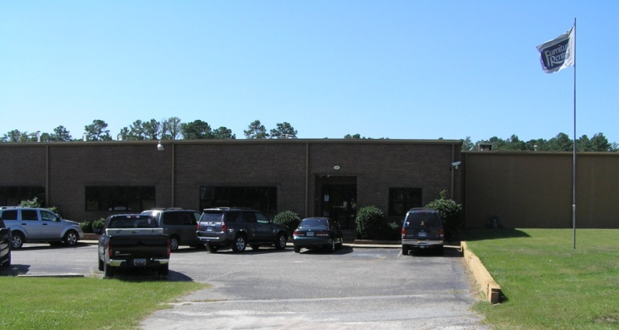
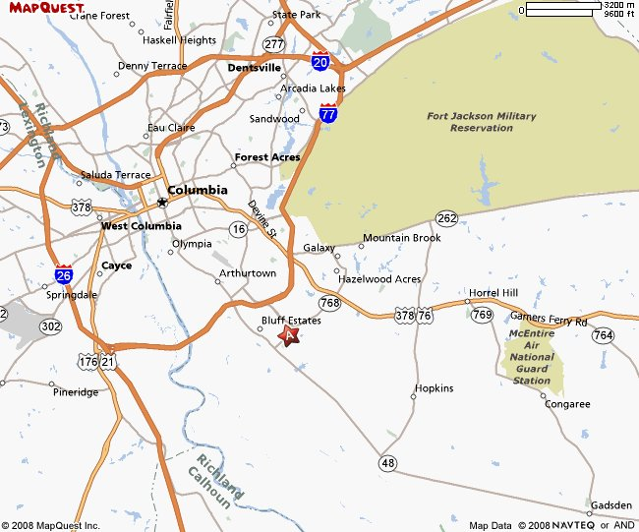
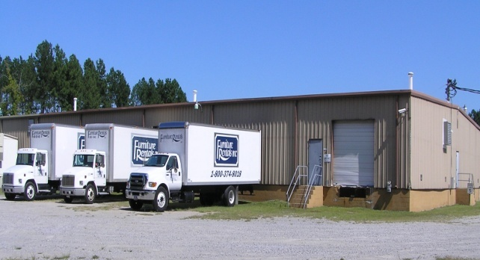
For Lease
110 Metal Park Drive
Columbia, SC 29209
$ 4.01 sq.ft warehouse
+ office suite: modified gross
28,175 sqft includes:
26,780 distribution warehouse,
1,395 sf office suite
Located in Industrial Park with close
access to I-77 and then I-20 & I-26
5 Truck Doors
16’ eve height, 13’-7 under beam
Ample yard space / Lot 7 Acres
Warehouse lighting and office utilities
included in rent
Rent includes all pass thru items and
lease includes provision for pro-rata
increases
Floor plan on reverse side
14,940 sf / $ 5,600 /mo*
Sale Price: $599,000
Directions:
From I-77, take Exit 6A, SC-768 / Shop Rd, Go 1.8 miles and turn right onto Pineview Rd., Turn right onto Metal Park Drive.
Offered by Carr Properties, LLC
OFFERED BY CARR PROPERTIES, LLC
Walter Carr, B.I.C.
843-744-2863 OFFICE 843-744-0321 FAX
carrpropllc@aol.com
www.carr-properties.com
COMMERCIAL REAL ESTATE ~ SALES ~ LEASING ~ MANAGEMENT ~ DEVELOPMENT

